Slide 1
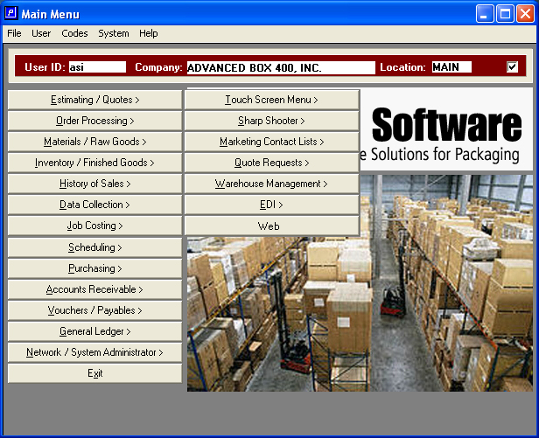
ADVANTZWARE for Windows
Advanced Software
Corrugated Box, Folding Carton, Manufacturing and Distribution Software
Notes:
*
07/16/96
*
##

Slide 2
History
Advanced Software, Inc.
Progress Software: “Future Proof”
  From Unix to Novell to MS Windows with no client “Upgrade Fees”
Advantzware:
  Folding Cartons
  Corrugated Boxes
  Kits, Sets & Point of Purchase Displays
  Distribution, Packaging Supplies & Stock Boxes
  Foam 2D and 3D
  Contract Pkg / Bill of Materials
  Laminated Single Face
  Assembled Partitions

Slide 3
ADVANTZWARE
SOFTWARE SUITE
ADVANTZWARE Options
Contact Marketing
Request for Quotation
Touch Sensitive Plant Data Collection
Sharp Shooter Bar Coded Inventory
Electronic Data Interchange
E-Business 24-7 Customer Service
Machine Visual Scheduling
Vendor Managed Warehouse Control
Optional EDI Integration Links
  Scheduling
  Cad Cam Integration
  Payroll Integration
  Fax & Email Services
ADVANTZWARE
Estimating & Quotations
Order Processing
Sales Service Queries
Cad & Die Images
Shipping
Billing
Purchasing
Schedule Backlog Reporting
Finished Goods
Raw Materials
Production Reporting
Job Costing
Sales History
Financial Accounting Modules

Slide 4
Ord Reports
Advantzware - Flow
Customer
Ord History
Estimate Cost Data
CAD-Spec
Order Query
Load tags
Estimating
Order Entry
BOM / Factory Tkt
From eCom
From RFQ
Inventory Allocation
Product Spec
Quote History
Quotations
Purchasing
Raw Inventory
Schl Brd
Touch Scrn
RF Bar Code
Line-up
Wk Sta Based
PO Receipts
Scheduling
Production Reporting
RF Bar Code
Accts Payable
WIP at Actual
FG Moves
FG Inv at Standard
Gen Ledger
RF Bar Code
BOL
Truck Loading
Accts Recv
Invoicing
Sales History

Slide 5
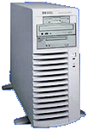

ASI ANYWARE WEB SOFTWARE
Database Server
Account
Inquiry
Request For Quote
Order Entry
Release Warehouse Items
Part # Inquiry
Sale Service Inquiry
Web Server

Slide 6
ASI ANYWARE FEATURES
Web Software for Customers, Sales Reps and Outside Employees
WEB SOFTWARE
Contact Marketing
Request for Quotes
Estimating
Order Entry for Supplies
Order Entry for Custom Boxes
Customer Service
Customer Inventory Reports
Account Status Inquiry
Customer Warehousing
Signed Bills - Proof of Delivery
CORPORATE BENEFITS
24/7 Access Anywhere, Anytime
24/7 Customer Service
Microsoft SQL & .Net Technology
Advantzware Integration
Employee Email Alerts
Customer Email Confirmations

Slide 7
ELECTRONIC DATA INTERCHANGE
Industry Leading EDI Integration
Computer to Computer Paper-Less Integration
Purchase Order Form 850 into Order Entry
Bill of Lading / Shipping Notices Form 856
Invoice Form 810
Product Catalog Form 832

Slide 8
CONTACT MARKETING
Advantzware Customer Down Load
Server to Laptop Link
Unlimited Contacts Per Company
Unlimited Mailing List by Salesman
Output To:
      Telemarketing List
      Mail Merge Document
      Mailing Labels

Slide 9
REQUEST FOR QUOTATION
Speeds Cost Estimating Bottleneck
Box Specifications Defined by Sales and Sales Service
Web Based Customer Box Requests via e-Advantzware
Automatic Estimate Creation via RFQ
Advantzware Integration for Existing Finished Goods

Slide 10
ESTIMATING
Folding Cartons
Laminated Single Face
Single Item w/Multiple Up
Back to Back Tandem Runs
Gang Runs w/ Unlimited Dies
Two Piece Boxes
Thermoforming & Plastics
Foil Stamping
Windowing
Automatic Machine Routing
Multiple Pass Printing
Nested Die Cutting
Much More
Corrugated Boxes
Foam 2D or 3D
Sets with Unlimited Parts
POP Displays
Nested Die Cuts
Assembled Partitions
Single Face Rolls
Sub Contract Work
Miscellaneous Materials
Wax Coating
Litho Laminated Labeling
Farm Outs
Automatic Unitization

Slide 11
ORDER PROCESSING
Custom Boxes via Quotes
Custom Boxes via Estimates
Stock Box & Distribution
J.I.T./Release from Inventory
Prioritized Price Matrix
Cash & Counter Sales
Unlimited Ship to / Dates Per Order
Warehouse Transfers via BOL
Bill Only or Ship Only Releases
Blind Shipments for Brokers
Multiple Orders per BOL
Invoice per Purchase Order or BOL

Slide 12
NORMAL MANUFACTING
PROCESS
Cost Estimating
Order
Entry
Job File
Release
Bill of Lading
Finished Goods
Invoice

Slide 13
STOCK BOX / JUST IN TIME MANUFACTURING PROCESS
Cost Estimating
Job File
Order
Entry
Release
Bill of Lading
Finished Goods
Invoice

Slide 14
PURCHASING
Raw Materials and Finished Goods
Automatic Purchase Order Creation by Job
Stock Sheets, Estimated Sheets and Roll Stock
Stocked / Non Stocked Flag or Supplies and Parts
Job Cost, Inventory and Accounts Payable Integration
Scheduled Delivery by Vendor
Vendor History Analysis

Slide 15
RAW MATERIALS
Perpetual Control by Warehouse, Bin and Tag
Warehouse Receipts, Issues, Transfers & Adjustments
Physical Count Processing
Global Price Changes by Vendor and Material Type
Vendor Price List
Estimated Material and Stocked Material
Sheets, Roll Stock, Parts, Plates, Dies & More
Reorder Advise Reporting

Slide 16
FINISHED GOODS...
Standard Cost Accounting
Perpetual Inventory Control
Just-In-Time & Custom Manufacturing
Unlimited Warehouse, Bin & Tags
Supplies, Farm outs, Distribution
Customer Aged Inventory
Assembled or Unassembled Sets

Slide 17
OFF-SITE CUSTOMER WAREHOUSE CONTROL
Add Customer Plants and Warehouses
Add Annual Consumption by Item
Maintain Weekly Consumption
Reorder Report including Inventory at Customer
Reorder Report utilizing Future Release Dates
Internet Based Customer Data Entry

Slide 18
SHARP SHOOTER BAR CODE INVENTORY CONTROL
Touch Screen Sensitive Rugged Tablet Technology
Radio Frequency Bar Code & Antenna Technology
Purchasing Receipts Create Bar Code Load Tags
Scan Material Receipts for Vendor Supplied Tags
Finished Goods Tags for Production Quantity
Bill of Lading Processing via Inventory Tags
Physical Counts, Transfers and Issues

Slide 19
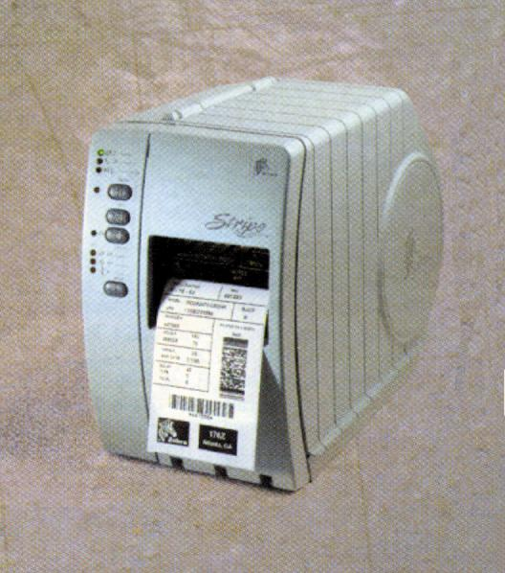
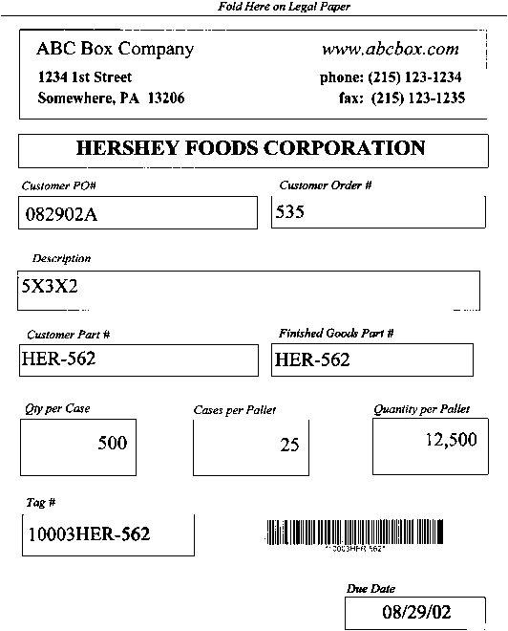
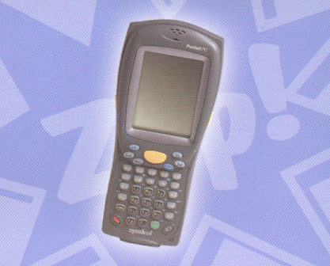
ADVANTZWARE “ FUTURE PROOF BOX SOFTWARE “
Unique Bar Code Numbering
Once orders or jobs are created for finished goods, unique bar coded case labels and load tag numbers are generated for each pallet count.
When purchase orders for raw materials are received, the system automatically creates unique bar codes for each material part number for tracking inventory by tag number, job number, unit count, warehouse and bin location.

Slide 20
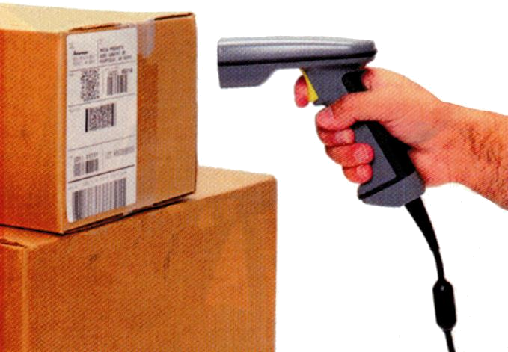
ADVANTZWARE “ FUTURE PROOF BOX SOFTWARE “
Finished Goods Inventory
Plant data collect tracks the last machine operation and prompts for the tag numbers for receiving goods into on hand quantity. The tag number will store job number unit count and other pertinent finished goods and customer information. Warehouse transactions such as receipts, transfers, adjustment and physical counts are a simply scan of the pallet tag followed by a scan of the warehouse and bin.
Bills of Lading
The shipping process is streamlined via touch sensitive bill of lading transactions, which prompt to scan each bar coded pallet tag when loading onto the truck.
Purchase Orders Receiving
If the vendor supplies bar coded load tags, the radio frequency scanner simply shoots each bar code and bin location to receive each pallet load of material. Alternatively, the purchase order receipt logic will automatically down load information to print the load tags for all raw goods or finished goods that are on the purchase order. This will create a unique load tag with bar code number based on the unit counts received for each pallet or roll.

Slide 21
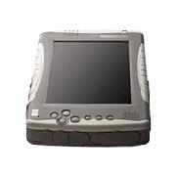
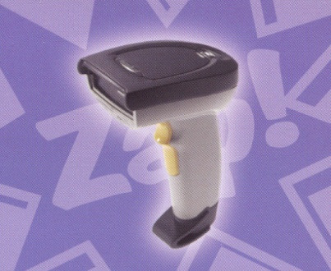

ADVANTZWARE “ FUTURE PROOF BOX SOFTWARE “
Rugged Tablet PC, Pocket PC and Scanner provide easy
Bar Code Scanning via Radio Frequency Technology
Both devices provide wireless connection via radio frequency antennae throughout the plant or warehouse. Touch sensitive screens provide easy navigation throughout the software modules. Simply press menu option such as Receive, Move, Transfer, Delete or Count, then scan the load tag, scan the warehouse location and inventory is done.
Issues of materials to jobs will prompt to scan the job number, then scan the roll tags or pallet tags used in the production process. This will reduce inventory levels and update the work in process automatically.
Shipments via bill of lading requires a scan of the release ticket number followed by a scan of each pallet tag, then press the print button and your finished. Of course the system will prevent duplicate scans or incorrect inventory. In addition, discrepancies in quantity will automatically generate an email to the sales service department.

Slide 22
PRODUCTION REPORTING
Back Office Machine Reporting by Job
Machine Efficiency Variance by Job
Machine Efficiency by Department and Shift
Machine Backlog Reporting
Machine Hours versus Estimated
Scrap Report by Machine
Material Allocations by Job

Slide 23
SHOP FLOOR PLANT
DATA COLLECTION
Plant Floor Collection by Machine Center
Unlimited Charge Codes by Machine
Department Notes by Machine Feeds Estimating
Automatic Job File Update on Machine Changes
Shift Reporting
Crew Size Override by Machine
Production and Waste Reporting

Slide 24
TOUCH SCREEN
SHOP FLOOR DATA COLLECTION
Touch Sensitive Screen Technology
Time Clock In / Clock Out Reporting
Man Hour Rates by Shift and Machine
Machine Hour Reporting by Job
Unlimited Shifts per Machine
One Button Job Charge Code Selection
Automatic Lunch, Breaks and Shift Recording
Automatic Dock Time & Lunch Pay
Payroll Time Card Report

Slide 25

ADVANTZWARE “ FUTURE PROOF BOX SOFTWARE “
Touch Sensitive Real Time Inventory Control
New touch sensitive screens (no keyboard required) located throughout the plant or mounted on forklifts in combination with radio frequency scanners speed the process for receipts, issues, shipments, transfers, adjustments and physical counting for both raw materials and finished goods. Simply press the touch sensitive inventory transaction type, then start scanning bar codes off each load tag label and the inventory is instantly updated.
Work in Progress & Job Costing
Raw material roll stock as well as sheets and other materials may be issued directly to the job’s work in process.This updates job costing and reduces inventory levels simply by scanning bar code tag numbers to streamline the process. Touch sensitive screens speed operators through the inventory transactions processes

Slide 26
JOB COSTING
Standard Cost Accounting into General Ledger
Estimated versus Actual Cost Reporting
Automatic Material Posting Option
Automatic Machine Posting Option
Integrated into Scheduling Systems
Waste Analysis by Machine by Job
Machine Efficiency by Hours and Quantity
Monthly Work In Process Costing

Slide 27
CAD-CAM LINKS
Barco-Artios Cad-Cam Integration
Dimensional Impressions Cad-Cam Integration
Job Data Downloaded to ODBC File
Job Tickets Complete with Graphics & Die Lines

Slide 28
SALES SERVICE
Order Inquiry Search by PO#, Customer, Part#, Job#, etc.
Order Inquiry shows open Due Dates by Customer
Finished Goods Receipts and Shipment History
Finished Goods Balances by Warehouse and Bin Location
Real Time Job Status Inquiry by Machine Operation
Scheduled Deliveries by Date and Ship Location
Invoice and Bill of Lading Detailed History
Account Balances and Open Order Balances

Slide 29
SALES HISTORY REPORTING
Period To Date Sales
Detail Sales Journal
Sales by Product
Salesman Performance
Salesman Production
Sales by Customer by Item
Profit by Item
Sales Volume
High Sales Tracking by Salesman
High Sales by Customer by Date Range
Profit by Invoice
Profit by Product by Salesman
Sales by Item by Customer
Sales by Shipping Carrier
Sales by Product with Cost

Slide 30
FINANCIAL ACCOUNTING
Accounts Payable
Accounts Receivable
General Ledger
Payroll Integration

Slide 31
SCHEDULING LINKS
Corrugated Technologies Scheduling Link
Kiwiplan Scheduling Link

Slide 32
Why ADVANTZWARE ?
“Your Last Conversion”
“FUTURE PROOF” DATABASE TECHNOLOGY
1991 Progress 4GL with SCO Unix
1993 Progress 4GL with Novell
1996 Progress 4GL with Windows, Text mode.
2001 Progress 4GL with Windows, GUI mode
Future Progress 4GL with Windowless Workstations with Linux Operating System or multi tier architecture?
FREE UPGRADES & FREEDOM TO SWITCH OPERATING SYSTEMS

Slide 33
Why Advantzware?
SUPERIOR SERVICE
On Line Documentation
On Line Field Sensitive Help
Hot Line Phone Support without Voice Mail
On Line Software Updates
File Transfers and Updates Upon Request
Remote Log On Help and Trouble Shooting
Internet Based Training
Affordable On-Site Training at $1000/Day
Affordable Custom Programming
Low Support Overhead Due To Progress Database for 15 Years

Slide 34
Why ADVANTZWARE ?
“Superior Real Time Web Interface”
Progress Spent Millions Developing Webspeed
Progress Webspeed is Superior to an ODBC Interface
Scalable to Thousands of Simultaneous Users
Sub-Second Response Times
Native Compiled Language Integration to Database
Web Based Record Locking
Transaction Roll Back Upon Web Errors
Two Phase Commit Integration to Database
Web Based Log-in Security
AOL Netscape or Microsoft Internet Explorer
Earthlink.com Process Thousands of Transaction per Second with Progress

Slide 35
Why ADVANTZWARE ?
Your Last Conversion with Progress 4gl Database
Future Proof - Compatible with Windows, Unix, Linux
Scalability to Thousands of Users
Webspeed Internet Access Superior to ODBC
Service and Support Second to None
Affordable On-Site Training Costs
Affordable Custom Programming
Affordable Annual Support - Due to Lower Overhead

Slide 36
Advanced Software
Makefield Executive Quarters
301 Oxford Valley Road, Suite 1713
Yardley, PA 19067
Phone: (215) 369-7800
Fax: (215) 369-7801
e-mail: sales@advantzware.com
Call for a FREE Demo (215) 369-7800

